Slide 1
CS294-129: Designing, Visualizing and Understanding Deep Neural Networks
John Canny
Fall 2016
Lecture 10: Recurrent Networks, LSTMs and Applications
Based on notes from Andrej Karpathy, Fei-Fei Li, Justin Johnson

Slide 2
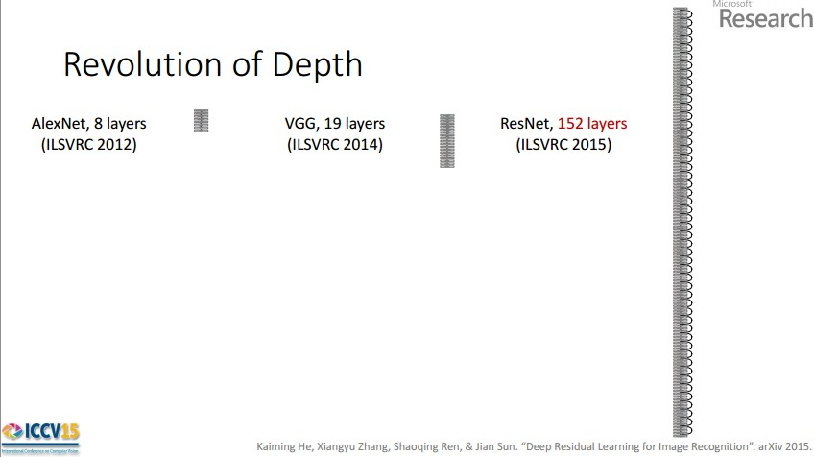
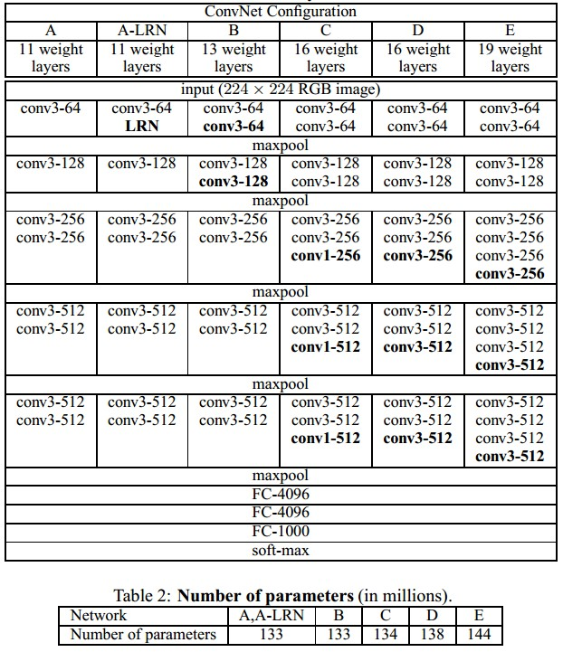


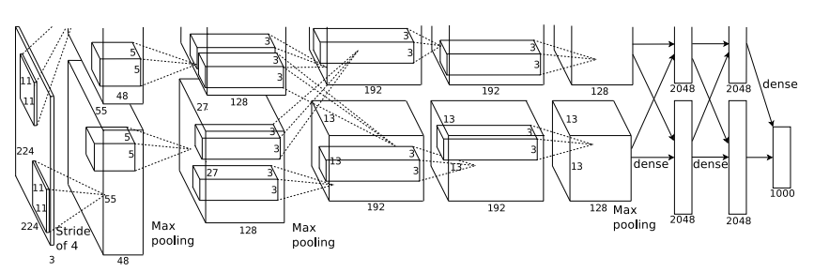
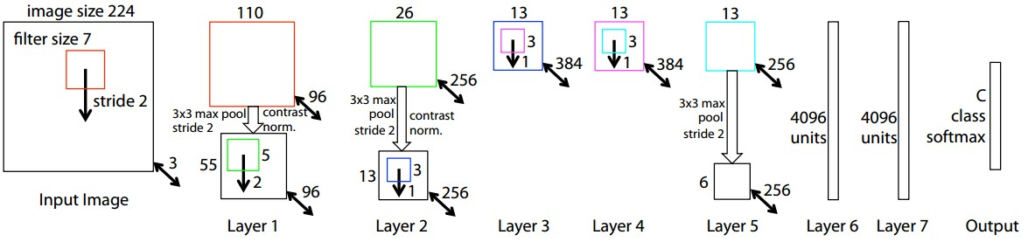
Last time: ConvNets

Slide 3
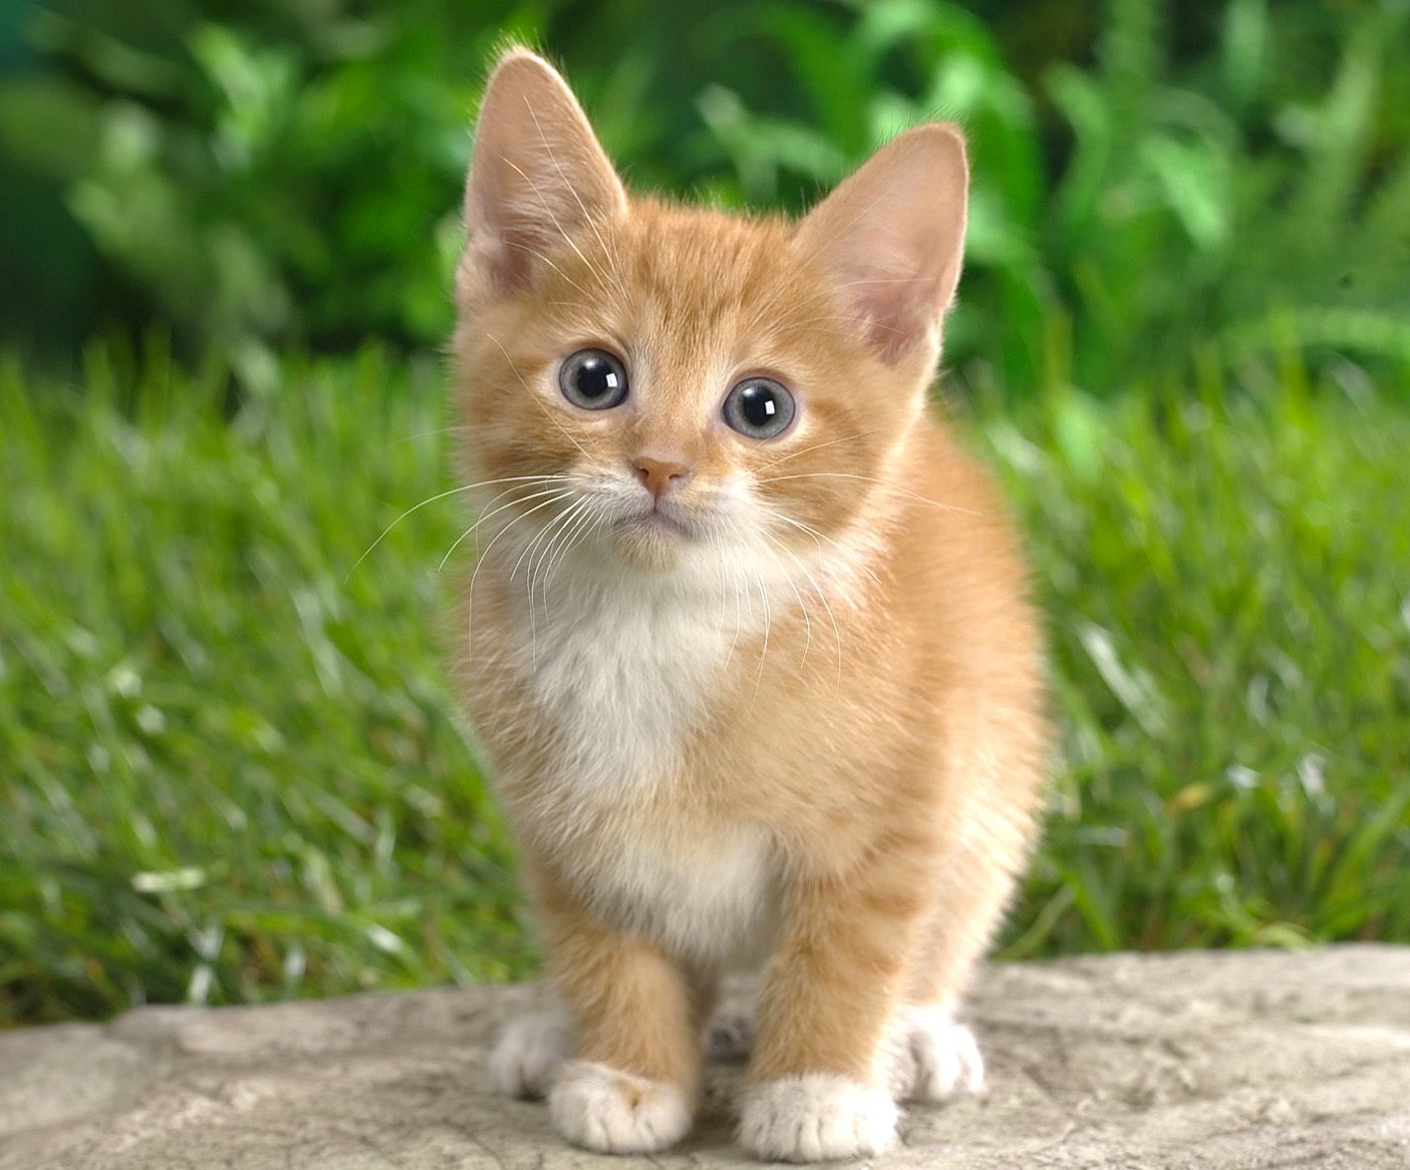
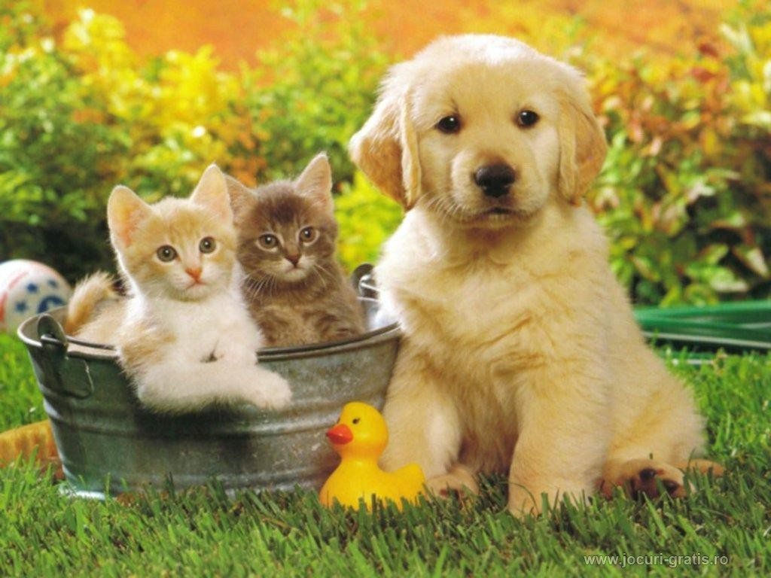
Last time: Localization and Detection
Classification
Classification + Localization
Object Detection
Instance Segmentation
CAT
CAT
CAT, DOG, DUCK
CAT, DOG, DUCK
Single object
Multiple objects

Slide 4
Neural Network structure
Standard Neural Networks are DAGs (Directed Acyclic Graphs). That means they have a topological ordering.
The topological ordering is used for activation propagation, and for gradient back-propagation.
They process one input instance at a time.
Conv 3x3
ReLU
Conv 3x3
+

Slide 5
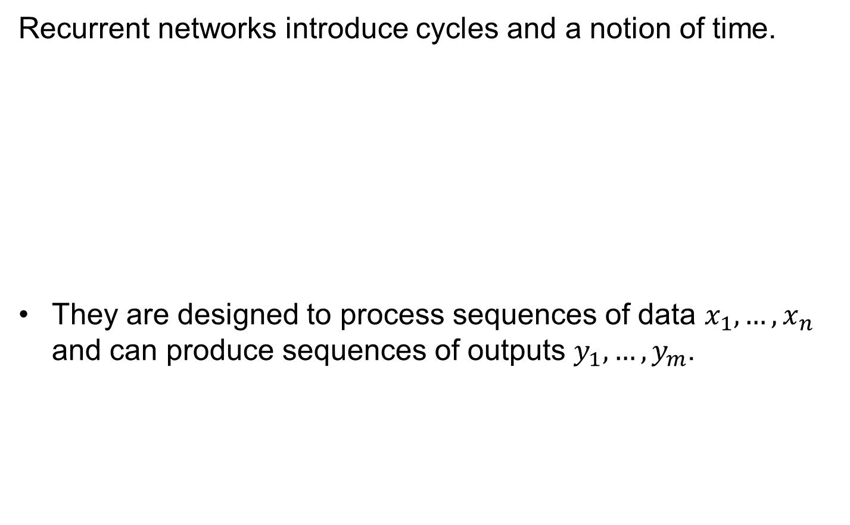
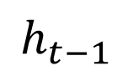
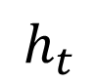
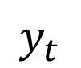
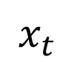
Recurrent Neural Networks (RNNs)
Recurrent networks introduce cycles and a notion of time.
They are designed to process sequences of data $x_{1},…,x_{n}$ and can produce sequences of outputs $y_{1},…,y_{m}$.
$$x_{t}$$
$$y_{t}$$
$$h_{t−1}$$
$$h_{t}$$
One-step delay

Slide 6
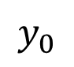
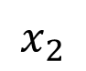
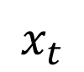
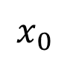
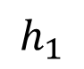
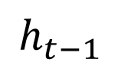
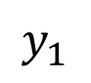
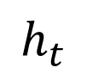
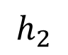
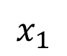
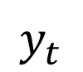
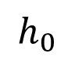
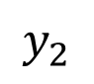
Unrolling RNNs
RNNs can be unrolled across multiple time steps.
This produces a DAG which supports backpropagation.
But its size depends on the input sequence length.
$$x_{t}$$
$$y_{t}$$
$$y_{0}$$
$$x_{0}$$
$$h_{t−1}$$
$$h_{t}$$
$$h_{0}$$
$$y_{1}$$
One-step delay
$$x_{1}$$
$$h_{1}$$
$$y_{2}$$
$$x_{2}$$
$$h_{2}$$

Slide 7
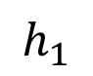
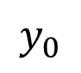
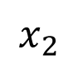
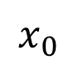
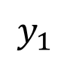
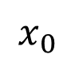
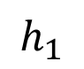
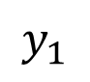
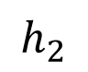
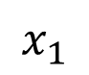
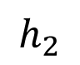
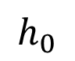
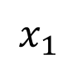
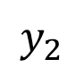
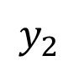
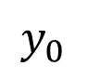
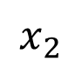
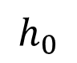
Unrolling RNNs
Usually drawn as:
$$y_{0}$$
$$x_{0}$$
$$h_{0}$$
$$y_{0}$$
$$y_{1}$$
$$y_{2}$$
$$y_{1}$$
$$x_{1}$$
$$h_{0}$$
$$h_{1}$$
$$h_{2}$$
$$h_{1}$$
$$y_{2}$$
$$x_{0}$$
$$x_{1}$$
$$x_{2}$$
$$x_{2}$$
$$h_{2}$$

Slide 8
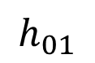
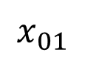
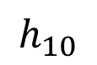
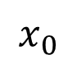
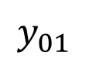
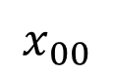
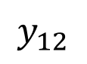
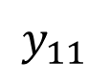










RNN structure
Often layers are stacked vertically (deep RNNs):
$$y_{10}$$
$$y_{11}$$
$$y_{12}$$
$$h_{10}$$
$$h_{11}$$
$$h_{12}$$
Same parameters at this level
$$x_{00}$$
$$x_{01}$$
$$x_{02}$$
≠
Abstraction
Higher level features
$$y_{00}$$
$$y_{01}$$
$$y_{02}$$
$$h_{00}$$
$$h_{01}$$
$$h_{02}$$
Same parameters at this level
$$x_{0}$$
$$x_{1}$$
$$x_{2}$$
Time

Slide 9
RNN structure
Backprop still works:
$$y_{10}$$
$$y_{11}$$
$$y_{12}$$
$$h_{10}$$
$$h_{11}$$
$$h_{12}$$
$$x_{00}$$
$$x_{01}$$
$$x_{02}$$
Activations
Abstraction
Higher level features
$$y_{00}$$
$$y_{01}$$
$$y_{02}$$
$$h_{00}$$
$$h_{01}$$
$$h_{02}$$
$$x_{0}$$
$$x_{1}$$
$$x_{2}$$
Time

Slide 10
RNN structure
Backprop still works:
$$y_{10}$$
$$y_{11}$$
$$y_{12}$$
$$h_{10}$$
$$h_{11}$$
$$h_{12}$$
$$x_{00}$$
$$x_{01}$$
$$x_{02}$$
Activations
Abstraction
Higher level features
$$y_{00}$$
$$y_{01}$$
$$y_{02}$$
$$h_{00}$$
$$h_{01}$$
$$h_{02}$$
$$x_{0}$$
$$x_{1}$$
$$x_{2}$$
Time

Slide 11
RNN structure
Backprop still works:
$$y_{10}$$
$$y_{11}$$
$$y_{12}$$
$$h_{10}$$
$$h_{11}$$
$$h_{12}$$
$$x_{00}$$
$$x_{01}$$
$$x_{02}$$
Activations
Abstraction
Higher level features
$$y_{00}$$
$$y_{01}$$
$$y_{02}$$
$$h_{00}$$
$$h_{01}$$
$$h_{02}$$
$$x_{0}$$
$$x_{1}$$
$$x_{2}$$
Time

Slide 12
RNN structure
Backprop still works:
$$y_{10}$$
$$y_{11}$$
$$y_{12}$$
$$h_{10}$$
$$h_{11}$$
$$h_{12}$$
$$x_{00}$$
$$x_{01}$$
$$x_{02}$$
Activations
Abstraction
Higher level features
$$y_{00}$$
$$y_{01}$$
$$y_{02}$$
$$h_{00}$$
$$h_{01}$$
$$h_{02}$$
$$x_{0}$$
$$x_{1}$$
$$x_{2}$$
Time

Slide 13
RNN structure
Backprop still works:
$$y_{10}$$
$$y_{11}$$
$$y_{12}$$
$$h_{10}$$
$$h_{11}$$
$$h_{12}$$
$$x_{00}$$
$$x_{01}$$
$$x_{02}$$
Activations
Abstraction
Higher level features
$$y_{00}$$
$$y_{01}$$
$$y_{02}$$
$$h_{00}$$
$$h_{01}$$
$$h_{02}$$
$$x_{0}$$
$$x_{1}$$
$$x_{2}$$
Time

Slide 14
RNN structure
Backprop still works:
$$y_{10}$$
$$y_{11}$$
$$y_{12}$$
$$h_{10}$$
$$h_{11}$$
$$h_{12}$$
$$x_{00}$$
$$x_{01}$$
$$x_{02}$$
Activations
Abstraction
Higher level features
$$y_{00}$$
$$y_{01}$$
$$y_{02}$$
$$h_{00}$$
$$h_{01}$$
$$h_{02}$$
$$x_{0}$$
$$x_{1}$$
$$x_{2}$$
Time

Slide 15
RNN structure
Backprop still works:
$$y_{10}$$
$$y_{11}$$
$$y_{12}$$
$$h_{10}$$
$$h_{11}$$
$$h_{12}$$
$$x_{00}$$
$$x_{01}$$
$$x_{02}$$
Activations
Abstraction
Higher level features
$$y_{00}$$
$$y_{01}$$
$$y_{02}$$
$$h_{00}$$
$$h_{01}$$
$$h_{02}$$
$$x_{0}$$
$$x_{1}$$
$$x_{2}$$
Time

Slide 16
RNN structure
Backprop still works:
$$y_{10}$$
$$y_{11}$$
$$y_{12}$$
$$h_{10}$$
$$h_{11}$$
$$h_{12}$$
$$x_{00}$$
$$x_{01}$$
$$x_{02}$$
Gradients
Abstraction
Higher level features
$$y_{00}$$
$$y_{01}$$
$$y_{02}$$
$$h_{00}$$
$$h_{01}$$
$$h_{02}$$
$$x_{0}$$
$$x_{1}$$
$$x_{2}$$
Time

Slide 17
RNN structure
Backprop still works:
$$y_{10}$$
$$y_{11}$$
$$y_{12}$$
$$h_{10}$$
$$h_{11}$$
$$h_{12}$$
$$x_{00}$$
$$x_{01}$$
$$x_{02}$$
Gradients
Abstraction
Higher level features
$$y_{00}$$
$$y_{01}$$
$$y_{02}$$
$$h_{00}$$
$$h_{01}$$
$$h_{02}$$
$$x_{0}$$
$$x_{1}$$
$$x_{2}$$
Time

Slide 18
RNN structure
Backprop still works:
$$y_{10}$$
$$y_{11}$$
$$y_{12}$$
$$h_{10}$$
$$h_{11}$$
$$h_{12}$$
$$x_{00}$$
$$x_{01}$$
$$x_{02}$$
Gradients
Abstraction
Higher level features
$$y_{00}$$
$$y_{01}$$
$$y_{02}$$
$$h_{00}$$
$$h_{01}$$
$$h_{02}$$
$$x_{0}$$
$$x_{1}$$
$$x_{2}$$
Time

Slide 19
RNN structure
Backprop still works:
$$y_{10}$$
$$y_{11}$$
$$y_{12}$$
$$h_{10}$$
$$h_{11}$$
$$h_{12}$$
$$x_{00}$$
$$x_{01}$$
$$x_{02}$$
Gradients
Abstraction
Higher level features
$$y_{00}$$
$$y_{01}$$
$$y_{02}$$
$$h_{00}$$
$$h_{01}$$
$$h_{02}$$
$$x_{0}$$
$$x_{1}$$
$$x_{2}$$
Time

Slide 20
RNN structure
Backprop still works:
$$y_{10}$$
$$y_{11}$$
$$y_{12}$$
$$h_{10}$$
$$h_{11}$$
$$h_{12}$$
$$x_{00}$$
$$x_{01}$$
$$x_{02}$$
Gradients
Abstraction
Higher level features
$$y_{00}$$
$$y_{01}$$
$$y_{02}$$
$$h_{00}$$
$$h_{01}$$
$$h_{02}$$
$$x_{0}$$
$$x_{1}$$
$$x_{2}$$
Time

Slide 21
RNN structure
Backprop still works:
$$y_{10}$$
$$y_{11}$$
$$y_{12}$$
$$h_{10}$$
$$h_{11}$$
$$h_{12}$$
$$x_{00}$$
$$x_{01}$$
$$x_{02}$$
Gradients
Abstraction
Higher level features
$$y_{00}$$
$$y_{01}$$
$$y_{02}$$
$$h_{00}$$
$$h_{01}$$
$$h_{02}$$
$$x_{0}$$
$$x_{1}$$
$$x_{2}$$
Time

Slide 22
RNN structure
Backprop still works:
$$y_{10}$$
$$y_{11}$$
$$y_{12}$$
$$h_{10}$$
$$h_{11}$$
$$h_{12}$$
$$x_{00}$$
$$x_{01}$$
$$x_{02}$$
Gradients
Abstraction
Higher level features
$$y_{00}$$
$$y_{01}$$
$$y_{02}$$
$$h_{00}$$
$$h_{01}$$
$$h_{02}$$
$$x_{0}$$
$$x_{1}$$
$$x_{2}$$
Time

Slide 23

Recurrent Networks offer a lot of flexibility:
Vanilla Neural Networks

Slide 24
Recurrent Networks offer a lot of flexibility:
e.g. Image Captioning
image -> sequence of words

Slide 25
Recurrent Networks offer a lot of flexibility:
e.g. Sentiment Classification
sequence of words -> sentiment

Slide 26
Recurrent Networks offer a lot of flexibility:
e.g. Machine Translation
seq of words -> seq of words

Slide 27
Recurrent Networks offer a lot of flexibility:
e.g. Video classification on frame level

Slide 28

Sequential Processing of fixed inputs
Multiple Object Recognition with Visual Attention, Ba et al.

Slide 29

Sequential Processing of fixed inputs
DRAW: A Recurrent Neural Network For Image Generation, Gregor et al.

Slide 30
Recurrent Neural Network
RNN
x

Slide 31
Recurrent Neural Network
y
usually want to predict a vector at some time steps
RNN
x

Slide 32

Recurrent Neural Network
We can process a sequence of vectors x by applying a recurrence formula at every time step:
y
RNN
new state
old state
input vector at some time step
some function
with parameters W
x

Slide 33
Recurrent Neural Network
We can process a sequence of vectors x by applying a recurrence formula at every time step:
y
RNN
Notice: the same function and the same set of parameters are used at every time step.
x

Slide 34

(Vanilla) Recurrent Neural Network
The state consists of a single “hidden” vector h:
y
RNN
x

Slide 35
Character-level language model example
Vocabulary:
[h,e,l,o]
Example training
sequence:
“hello”
y
RNN
x

Slide 36

Character-level language model example
Vocabulary:
[h,e,l,o]
Example training
sequence:
“hello”

Slide 37
Character-level anguage model example
Vocabulary:
[h,e,l,o]
Example training
sequence:
“hello”

Slide 38
Character-level language model example
Vocabulary:
[h,e,l,o]
Example training
sequence:
“hello”

Slide 39


min-char-rnn.py gist: 112 lines of Python
(https://gist.github.com/karpathy/d4dee566867f8291f086)

Slide 40

min-char-rnn.py gist
Data I/O

Slide 41

min-char-rnn.py gist
Initializations
recall:

Slide 42

min-char-rnn.py gist
Main loop

Slide 43
min-char-rnn.py gist
Main loop

Slide 44
min-char-rnn.py gist
Main loop

Slide 45
min-char-rnn.py gist
Main loop

Slide 46
min-char-rnn.py gist
Main loop

Slide 47

min-char-rnn.py gist
Loss function
forward pass (compute loss)
backward pass (compute param gradient)

Slide 48

min-char-rnn.py gist
Softmax classifier

Slide 49

min-char-rnn.py gist
recall:

Slide 50

min-char-rnn.py gist

Slide 51

y
RNN
x

Slide 52


Slide 53



at first:
train more
train more
train more

Slide 54



Slide 55

open source textbook on algebraic geometry
Latex source

Slide 56


Slide 57


Slide 58


Slide 59

Generated
C code

Slide 60


Slide 61


Slide 62

Searching for interpretable cells
[Visualizing and Understanding Recurrent Networks, Andrej Karpathy*, Justin Johnson*, Li Fei-Fei]

Slide 63

Searching for interpretable cells
quote detection cell

Slide 64

Searching for interpretable cells
line length tracking cell

Slide 65

Searching for interpretable cells
if statement cell

Slide 66

Searching for interpretable cells
quote/comment cell

Slide 67

Searching for interpretable cells
code depth cell

Slide 68

Image Captioning
Explain Images with Multimodal Recurrent Neural Networks, Mao et al.
Deep Visual-Semantic Alignments for Generating Image Descriptions, Karpathy and Fei-Fei
Show and Tell: A Neural Image Caption Generator, Vinyals et al.
Long-term Recurrent Convolutional Networks for Visual Recognition and Description, Donahue et al.
Learning a Recurrent Visual Representation for Image Caption Generation, Chen and Zitnick

Slide 69
Recurrent Neural Network
Convolutional Neural Network

Slide 70

test image

Slide 71

test image

Slide 72
test image
X

Slide 73
test image
x0
<START>
<START>

Slide 74
test image
y0
before:
h = tanh(Wxh * x + Whh * h)
now:
h = tanh(Wxh * x + Whh * h + Wih * v)
h0
Wih
x0
<START>
v
<START>

Slide 75
test image
y0
sample!
h0
x0
<START>
straw
<START>

Slide 76
test image
y0
y1
h0
h1
x0
<START>
straw
<START>

Slide 77
test image
y0
y1
h0
h1
sample!
x0
<START>
straw
hat
<START>

Slide 78
test image
y0
y1
y2
h0
h1
h2
x0
<START>
straw
hat
<START>

Slide 79
test image
y0
y1
y2
sample
<END> token
=> finish.
h0
h1
h2
x0
<START>
straw
hat
<START>

Slide 80

Image Sentence Datasets
Microsoft COCO
[Tsung-Yi Lin et al. 2014]
mscoco.org
currently:
~120K images
~5 sentences each

Slide 81


Slide 82


Slide 83

Preview of fancier architectures
RNN attends spatially to different parts of images while generating each word of the sentence:
Show Attend and Tell, Xu et al., 2015

Slide 84



LSTM: Long Short-Term Memory
Vanilla RNN:
LSTM:

Slide 85




LSTM

Slide 86
Long Short Term Memory (LSTM)
[Hochreiter et al., 1997]
vector from
below (x)
W
x
sigmoid
i
h
sigmoid
f
vector from
before (h)
sigmoid
o
tanh
g
4n x 2n
4n
4*n

Slide 87
Long Short Term Memory (LSTM)
[Hochreiter et al., 1997]
cell
state c
x
f

Slide 88
Long Short Term Memory (LSTM)
[Hochreiter et al., 1997]
cell
state c
x
+
x
f
i
g

Slide 89
Long Short Term Memory (LSTM)
[Hochreiter et al., 1997]
cell
state c
x
+
c
x
tanh
f
i
g
o
x
h

Slide 90
Long Short Term Memory (LSTM)
[Hochreiter et al., 1997]
higher layer, or prediction
cell
state c
x
+
c
x
tanh
f
i
g
o
x
h

Slide 91
LSTM
one timestep
one timestep
cell
state c
x
+
x
+
tanh
tanh
x
x
f
x
f
x
i
g
i
g
o
o
h
h
h
x
x

Slide 92
RNN
state
f
f
f
f
f
f
LSTM
(ignoring forget gates)
+
+
+

Slide 93



Recall: “PlainNets” vs. ResNets
ResNet is to PlainNet what LSTM is to RNN, kind of.

Slide 94

Understanding gradient flow dynamics
Cute backprop signal video: http://imgur.com/gallery/vaNahKE

Slide 95
Understanding gradient flow dynamics
if the largest eigenvalue is > 1, gradient will explode
if the largest eigenvalue is < 1, gradient will vanish
[On the difficulty of training Recurrent Neural Networks, Pascanu et al., 2013]

Slide 96
Understanding gradient flow dynamics
if the largest eigenvalue is > 1, gradient will explode
if the largest eigenvalue is < 1, gradient will vanish
can control exploding with gradient clipping
can control vanishing with LSTM
[On the difficulty of training Recurrent Neural Networks, Pascanu et al., 2013]

Slide 97


LSTM variants and friends
[An Empirical Exploration of Recurrent Network Architectures, Jozefowicz et al., 2015]
[LSTM: A Search Space Odyssey,
Greff et al., 2015]
GRU [Learning phrase representations using rnn encoder-decoder for statistical machine translation, Cho et al. 2014]

Slide 98
Summary
RNNs allow a lot of flexibility in architecture design
Vanilla RNNs are simple but don’t work very well
Common to use LSTM or GRU: their additive interactions improve gradient flow
Backward flow of gradients in RNN can explode or vanish. Exploding is controlled with gradient clipping. Vanishing is controlled with additive interactions (LSTM)
Better/simpler architectures are a hot topic of current research
Better understanding (both theoretical and empirical) is needed.

